Slide 1
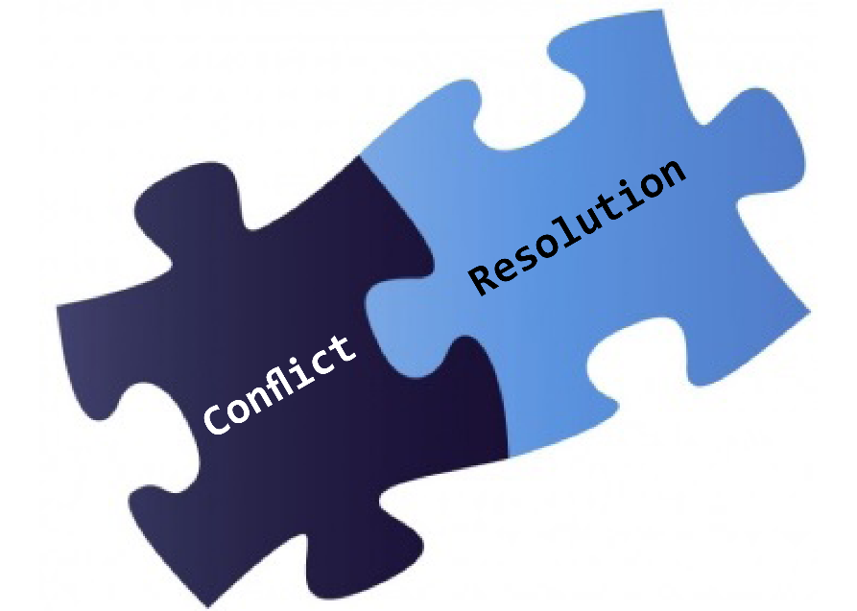
Secrets of Conflict Resolution
Chad Green

Slide 2
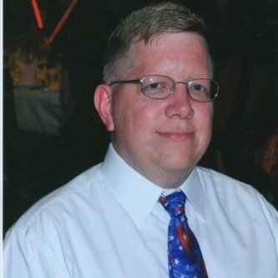
Who is Chad Green?
Service Delivery Manager at Hewlett Packard Enterprise
Previous Positions
Product Delivery Manager
Project Manager
.NET Solution Architect
Developer
Community Involvement
Code PaLOUsa Conference Chair
Louisville .NET Meetup Organizer
Contact Information
Email: chadgreen@chadgreen.com
Blog: chadgreen.com
Twitter: @ChadGreen
LinkedIn: ChadwickEGreen

Slide 3
Agenda
Who is Chad Green
Setting the Stage
Approaches to Conflict Resolution
Understanding Group Dynamics
Managing Conflict
Conclusion

Slide 4
By the Numbers
85%
$359
27%
25%
85% of U.S. employees experience conflict and spend 2.8 hours/week dealing with it
Significant loss of organizational productivity and resources costs $359 billion in paid hours a year
27% of employees witnessed personal attacks
25% say avoiding it results in sickness/absences
31%
78%
95%
60%
75%
31% of managers think they handle conflict effectively
78% of employees disagree
95% of those who receive training say it is the biggest driver for success
Nearly 60% have never received training
75% of employees report positive outcomes from conflict that would have not been realized without the conflict

Slide 5
“Peace is not absence of conflict, it is the ability to handle conflict by peaceful means.”
Ronald Reagan

Slide 6
Setting the Stage
What is Conflict and Conflict Resolution

Slide 7
What is Conflict?
A serious disagreement or argument, typically a protracted one
A state of disagreement or disharmony between persons or ideas; a clash
Strong disagreement between people, groups, etc., that results in often angry argument
A turning point during which an individual struggles to attain some psychological quality.
Can be a time of both vulnerability and strength, as the individual works toward success or failure
Real or perceived threat or opposition to one’s needs, interests, principles, concerns, or security
Notes:
Conflict is “a situation of competition in which the parties are aware of the incompatibility of potential future positions and in which each party wishes to occupy a position which is incompatible with the wishes of the other.” Conflict is viewed as a cycle: “As with any social process, there are causes; also, there is a core process, which has results or effects. These effects feed back to effect the causes.” To understand conflict further, the situation must include elements of interdependence, emotions, perceptions, and behaviors. For example, conflict occurs between parties whose tasks are interdependent, who are angry with each other, who perceive the other party as being in fault, and whose actions cause a business problem.
Conflict can be constructive and healthy for an organization. It can aid in developing individuals and improving the organization by building on the individual assets of its members. Conflict can bring about underlying issues. It can force people to confront possible defects in a solution and choose a better one. The understanding of real interests, goals, and needs is enhanced and ongoing communication around those issues is induced. In addition, it can prevent premature and inappropriate resolution of conflict. Constructive conflict occurs when people change and grow personally from the conflict, involvement of the individuals affected by the conflict is increased, cohesiveness is formed among team members, and a solution to the problem is found. However, if conflict is not managed properly, it can be detrimental to an organization by threatening organization unity, business partnerships, and interpersonal connections. Deconstructive conflict occurs when a decision has not been found and the problem remains, energy is taken away from more important activities or issues, morale of teams or individuals is destroyed, and groups of people or teams are polarized.
Destructive conflict has a predictable pattern known as the Drama Triangle. By learning how to identify these unproductive roles and how to effectively handle each role player, managers can prevent some conflicts and resolve those that do. Most individuals know how to to assume the following three roles:
Persecutor refers to a person who uses aggressive behavior against another person, attacking the intended victim. An attack can be direct or indirect and be physical, verbal, or both. The persecutor’s actions deliver a message that “you are not ok” while making the persecutor feel righteous and superior.
Victim refers to a person who uses nonassertive behavior so others view them as “I’m not okay.” This behavior encourages others to either rescue or persecute the victim. Victims will feel helpless, inadequate, sad, scared, or guilty. The victim role is often used because the individual is feeling stressed, has low self-esteem, or is being persecuted by another.
Rescuer refers to a person who uses either nonassertive or aggressive behavior. Individuals become rescuers because they will not say “no” and unwillingly assume the responsibility of solving the victim’s problem. In contrast, others will assume the rescuer role to demonstrate superiority over the victim.
These roles are learned in early childhood and are used throughout adulthood. They involve the perception of oneself or someone else as inadequate or not acceptable. The aggressive and nonassertive behaviors that are present in these roles lead to win-lose outcomes and do not provide an opportunity for a win-win resolution.

Slide 8



What is Conflict?
Good discussion about the possibilities
Not too bad, but still not good
Things starting to fall apart
Notes:
This is a sample Three Pictures with Captions slide ideal for including three pictures with brief, bulleted text.
To Replace the Pictures on this Sample Slide (this applies to all slides in this template that contain replaceable pictures)
Select the sample picture and press Delete. Click the icon inside the shape to open the Insert Picture dialog box. Navigate to the location where the picture is stored, select desired picture and click on the Insert button to fit the image proportionally within the shape.
Note: Do not right-click the image to change the picture inside the picture placeholder. This will change the frame size of the picture placeholder. Instead, follow the steps outlined above.
Tip: use the Crop tool to reposition a picture within a placeholder. From the Picture Tools Format tab on the ribbon, click the Crop button. Click and drag the picture within the placeholder to reposition. To scale the picture within the placeholder (while Crop is active), grab a round corner handle and drag to resize. Hold Shift key to constrain picture aspect ratio when resizing.

Slide 9
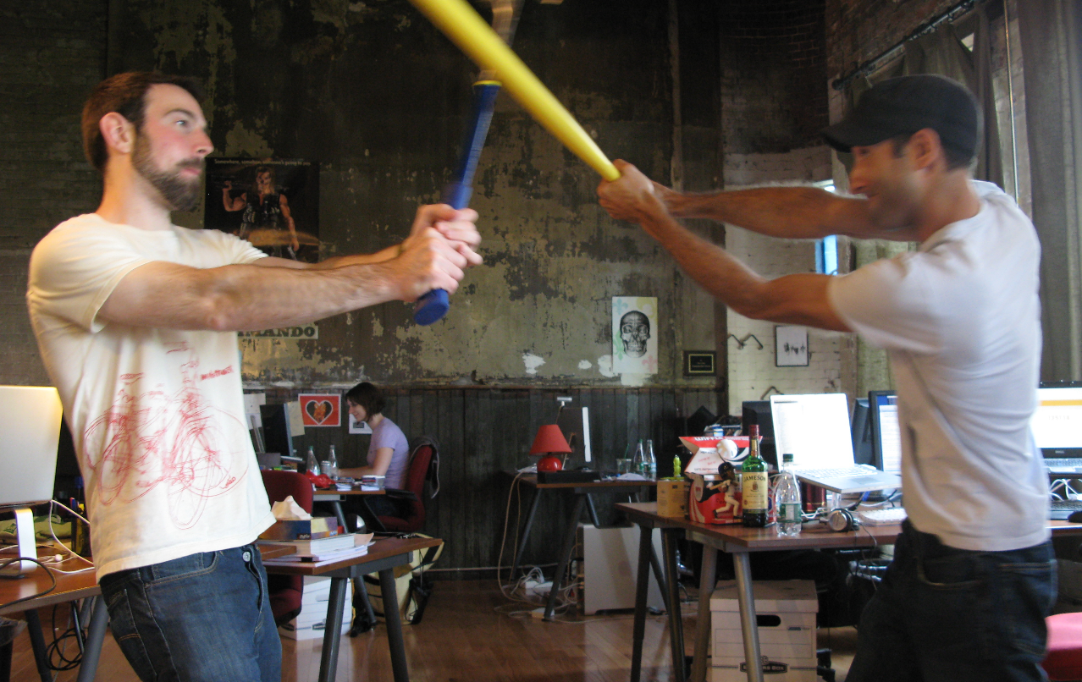
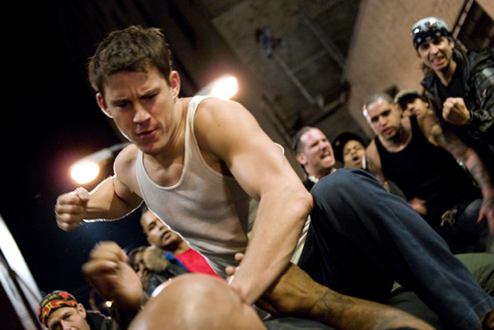
What is Conflict?
Oh goodness, this cannot be good
Now this is really serious
Notes:
This is a sample Two Pictures with Captions slide ideal for including two pictures with brief descriptive statements.
To Replace the Pictures on this Sample Slide (this applies to all slides in this template that contain replaceable pictures)
Select the sample picture and press Delete. Click the icon inside the shape to open the Insert Picture dialog box. Navigate to the location where the picture is stored, select desired picture and click on the Insert button to fit the image proportionally within the shape.
Note: Do not right-click the image to change the picture inside the picture placeholder. This will change the frame size of the picture placeholder. Instead, follow the steps outlined above.
Tip: use the Crop tool to reposition a picture within a placeholder. From the Picture Tools Format tab on the ribbon, click the Crop button. Click and drag the picture within the placeholder to reposition. To scale the picture within the placeholder (while Crop is active), grab a round corner handle and drag to resize. Hold Shift key to constrain picture aspect ratio when resizing.

Slide 10

Notes:
This is a sample Title Slide with Picture ideal for including a dark picture with a brief title and subtitle.
A selection of pre-approved title slides are available in the HPE Title Slide Library. The location of the library will be communicated later.
To insert a slide with a different picture from the HPE Title Slide Library:
Open the file HPE_16x9_Title_Slide_Library.pptx
From the Slide thumbnails pane, select the slide with the picture you would like to use in your presentation and click Copy (Ctrl+C)
Open a copy of the new HPE 16x9 template (Standard or Events) or your current presentation
In the Slide thumbnails pane, click Paste (Ctrl+V)
A Paste Options clipboard icon will appear. Click the icon and select Keep Source Formatting. (Ctrl+K)

Slide 11
Notes:
This is a sample Title Slide with Picture ideal for including a dark picture with a brief title and subtitle.
A selection of pre-approved title slides are available in the HPE Title Slide Library. The location of the library will be communicated later.
To insert a slide with a different picture from the HPE Title Slide Library:
Open the file HPE_16x9_Title_Slide_Library.pptx
From the Slide thumbnails pane, select the slide with the picture you would like to use in your presentation and click Copy (Ctrl+C)
Open a copy of the new HPE 16x9 template (Standard or Events) or your current presentation
In the Slide thumbnails pane, click Paste (Ctrl+V)
A Paste Options clipboard icon will appear. Click the icon and select Keep Source Formatting. (Ctrl+K)

Slide 12
Notes:
This is a sample Title Slide with Picture ideal for including a dark picture with a brief title and subtitle.
A selection of pre-approved title slides are available in the HPE Title Slide Library. The location of the library will be communicated later.
To insert a slide with a different picture from the HPE Title Slide Library:
Open the file HPE_16x9_Title_Slide_Library.pptx
From the Slide thumbnails pane, select the slide with the picture you would like to use in your presentation and click Copy (Ctrl+C)
Open a copy of the new HPE 16x9 template (Standard or Events) or your current presentation
In the Slide thumbnails pane, click Paste (Ctrl+V)
A Paste Options clipboard icon will appear. Click the icon and select Keep Source Formatting. (Ctrl+K)

Slide 13
What is Conflict Resolution?
Way for two or more parties to find a peaceful solution to a disagreement among them
Methods and processes involved in facilitating the peaceful ending conflict
Committed groups actively communicate information about their conflicting motives to the rest of the group
Engaging in collective negotiation
Typically parallel the dimensions of conflict in the way the conflict is processed
Cognitive Resolution
Emotional Resolution
Behavioral Resolution

Slide 14
Approaches to Conflict Resolution

Slide 15
Collaborating
Problem Solving, Confronting, Integrating, Win-Win Style
Description
When to Use
Incorporating multiple viewpoints and insights from different perspectives
Involves a rational problem-solving approach
Involves
Focusing on the issues
Looking at alternative approaches
Selecting the best alternative
Consensus and commitment of others important
Collaborative environment
Required to address the interest of multiple stakeholders
High level of trust is present
Long-term relationship is important
Need to work through hard feelings, animosity, etc.
Do not want to have full responsibility

Slide 16
Collaborating
Problem Solving, Confronting, Integrating, Win-Win Style
Advantages
Disadvantages
Leeds to solving the actual problem
Leeds to a win-win outcome
Reinforces mutual trust and respect
Builds a foundation for effective collaboration in the future
Shared responsibility of the outcome
You earn the reputation of a good negotiator
Outcome of the conflict resolution is less stressful
Requires a commitment from all parties
May require more effort and more time
May not be practical when timing is crucial and a quick solution or fast response is required
Involved parties must continue collaborative efforts to maintain a collaborative relationship

Slide 17
Compromising
Give and Take, Reconciling
Description
When to Use
Conflicting parties bargain to reach a mutually acceptable solution
Lose/Lose
Both parties need to win
Goals are moderately important / not worth the use of more assertive involving approaches
Teach temporary settlement on complex issues
Reach expedient solutions on important issues
First step when involved parties do not know each other
When collaboration or forcing do not work

Slide 18
Compromising
Give and Take, Reconciling
Advantages
Disadvantages
Faster issue resolution
Can provide a temporary solution while looking for a win-win solution
Lowers the level of tension and stress resulting from the conflict
May result in a situation when both parties are not satisfied with the outcome
Does not contribute to building trust in the long run
May require close monitoring and control

Slide 19
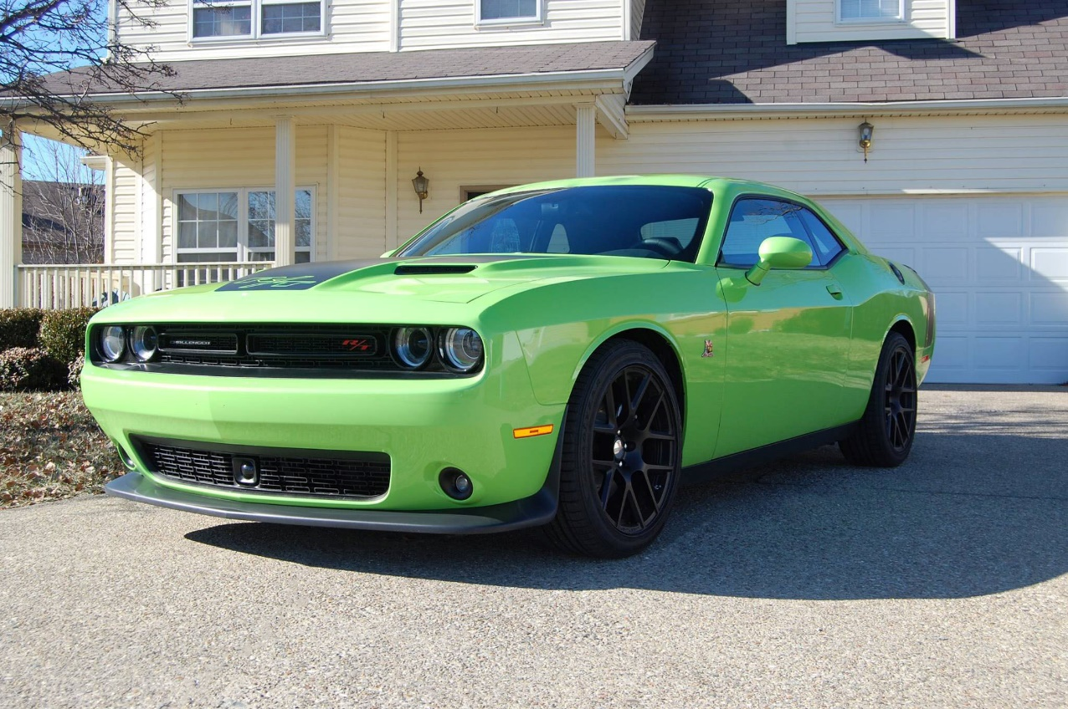
Smoothing
Accommodating, Obliging
Description
When to Use
Areas of agreement are emphasized
Areas of disagreement are downplayed
Important to provide a temporary relief or buy time
Issue is not as important to you as it is to the other person
You accept you are wrong
You have no choice or when continued competition would be detrimental

Slide 20
Smoothing
Accommodating, Obliging
Advantages
Disadvantages
Helps to protect more important interests while give up on less important ones
Gives an opportunity to reassess the situation from a different angle
Risk of being abused
May negatively affect your confidence in your ability to respond to an aggressive opponent
Makes it more difficult to transition to a win-win solution in the future
Some of your supporters may not like your smoothing response and be turned off

Slide 21
Forcing
Directing, Competing, Controlling, Dominating
Description
When to Use
Involves pushing one viewpoint at the expense of another
Generates a win-lose situation
Assertiveness is the hallmark of this approach
Addresses the conflict head-on
All other, less forceful methods, do not work or are ineffective
Need to stand up for your own rights, resist aggression and pressure
Quick resolution is required and using force if justified
As a last resort to resolve a long-lasting conflict

Slide 22
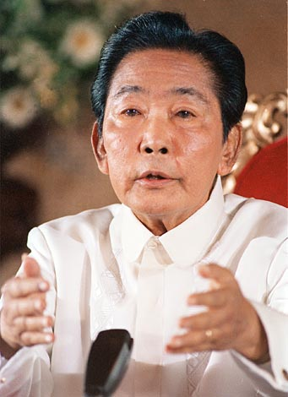
Forcing
Directing, Competing, Controlling, Dominating
Advantages
Disadvantages
May provide a quick resolution
Increases self-esteem and draws respect
May negatively affect relationship in the long run
May cause opponent to react in the same way
May require a lot of energy and may be exhausting
Cannot take advantage of strong sides of the other side’s position

Slide 23
Withdrawal
Avoidance
Description
When to Use
Retreat or postpone a decision on a problem
Usually not the best choice for resolving conflict
Not giving up – sidestepping or postponing
Issue is trivial and not worth the effort
More important issues are pressing
Postponing the response is beneficial to you
No change of getting your concerns met
You would have to deal with hostility
Unable to handle the conflict

Slide 24
Withdrawal
Avoidance
Advantages
Disadvantages
You may chose to withdraw and postpone your response until you are in a more favorable circumstance
Low stress approach when conflict is short
Gives the ability/time to focus on more important or more urgent issues
Give you time to be better prepared
May lead to weakening or losing your position
Not acting may be interpreted as an agreement
May negatively affect your relationship with a party that expects your action

Slide 25
Understanding Group Dynamics
Transactional Analysis

Slide 26
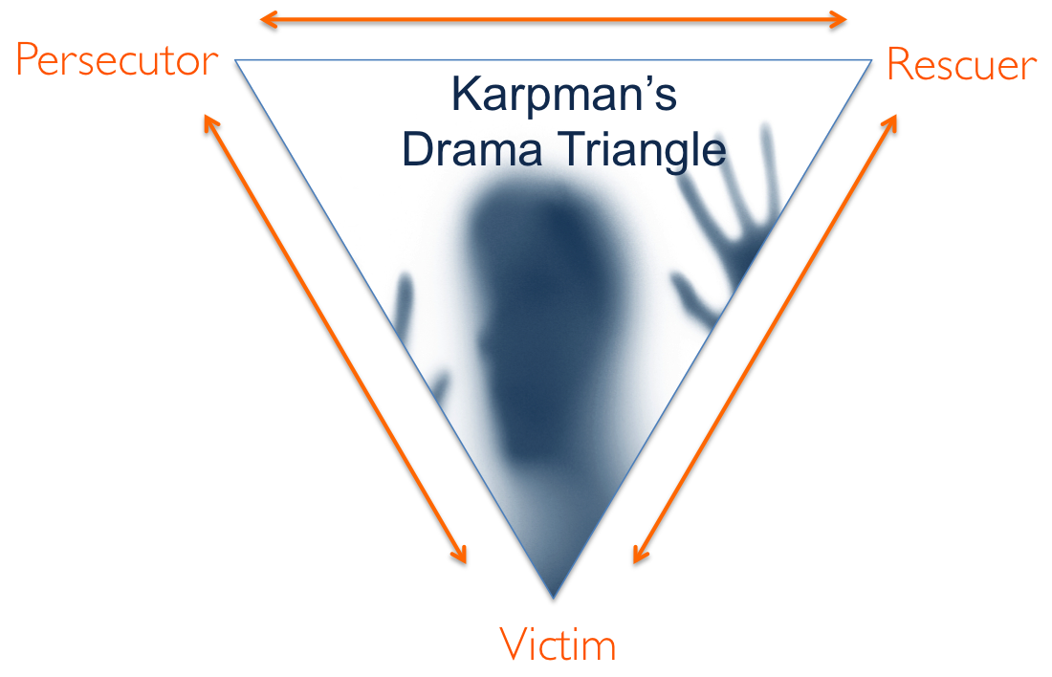
Karpman Drama Triangle
Conflict has predictable pattern known as the Karpman Drama Triangle
Models the connection between personal responsibility and the power in conflicts, and destructive and shifting roles people play
3 Roles
Persecutor
Rescuer
Victim

Slide 27
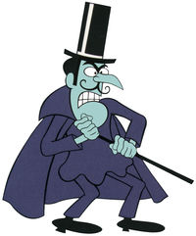
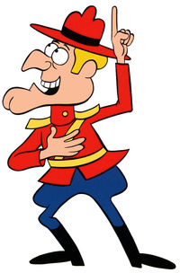

Karpman Drama Triangle
Persecutor
Rescuer
Victim

Slide 28
Managing Conflict
10 Tips to Make you a Conflict Resolution Superstar

Slide 29
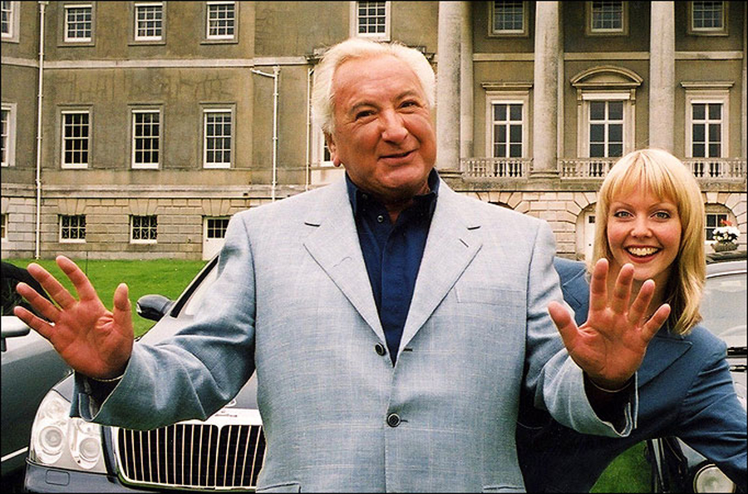
10 Tips to Make You a Conflict Resolution Superstar
Tackle the issue after both parties have calmed down

Slide 30

10 Tips to Make You a Conflict Resolution Superstar
Tackle the issue after both parties have calmed down
Maintain a positive outlook

Slide 31

10 Tips to Make You a Conflict Resolution Superstar
Tackle the issue after both parties have calmed down
Maintain a positive outlook
Practice active listening

Slide 32
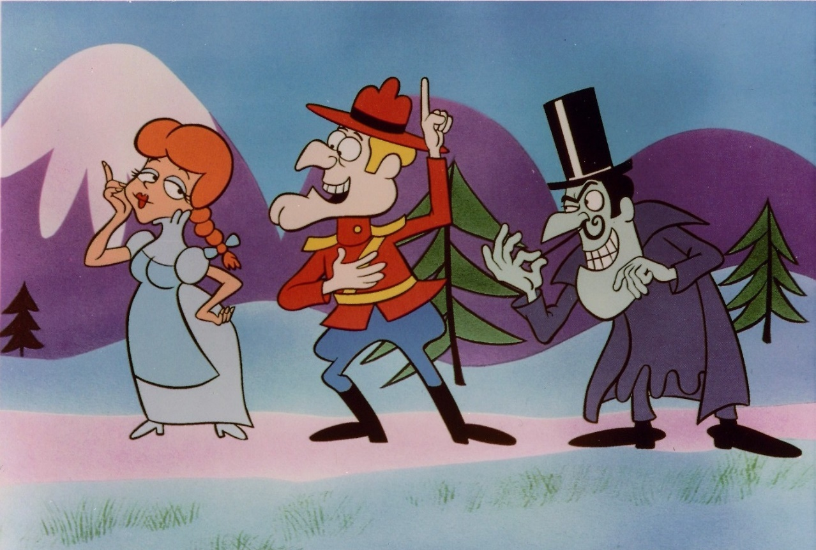
10 Tips to Make You a Conflict Resolution Superstar
Tackle the issue after both parties have calmed down
Maintain a positive outlook
Practice active listening
Consider your role in the conflict

Slide 33

10 Tips to Make You a Conflict Resolution Superstar
Tackle the issue after both parties have calmed down
Maintain a positive outlook
Practice active listening
Consider your role in the conflict
Organize a staff meeting

Slide 34

10 Tips to Make You a Conflict Resolution Superstar
Tackle the issue after both parties have calmed down
Maintain a positive outlook
Practice active listening
Consider your role in the conflict
Organize a staff meeting
Seek first to understand

Slide 35

10 Tips to Make You a Conflict Resolution Superstar
Tackle the issue after both parties have calmed down
Maintain a positive outlook
Practice active listening
Consider your role in the conflict
Organize a staff meeting
Seek first to understand
Alert human resources

Slide 36

10 Tips to Make You a Conflict Resolution Superstar
Tackle the issue after both parties have calmed down
Maintain a positive outlook
Practice active listening
Consider your role in the conflict
Organize a staff meeting
Seek first to understand
Alert human resources
Find a mediator

Slide 37
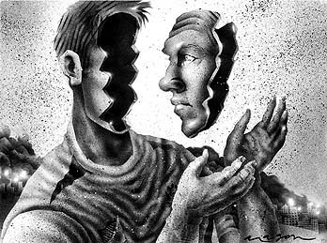
10 Tips to Make You a Conflict Resolution Superstar
Tackle the issue after both parties have calmed down
Maintain a positive outlook
Practice active listening
Consider your role in the conflict
Organize a staff meeting
Seek first to understand
Alert human resources
Find a mediator
Be introspective

Slide 38

10 Tips to Make You a Conflict Resolution Superstar
Tackle the issue after both parties have calmed down
Maintain a positive outlook
Practice active listening
Consider your role in the conflict
Organize a staff meeting
Seek first to understand
Alert human resources
Find a mediator
Be introspective
Expect Conflict

Slide 39
Conclusion

Slide 40
Thank you
Secrets of Conflict Resolution
Nebraska.Code()
Email: chadgreen@chadgreen.com
Blog: chadgreen.com
Twitter: @ChadGreen
LinkedIn: ChadwickEGreen

